Slide 1
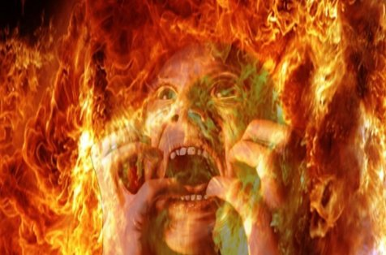
A Hell of a Problem
St Michael and All Angels
(8 Dec 2012)

Slide 2
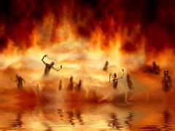
Traditional views of hell: Eternal conscious torment
This view is based on certain biblical language
“… eternal punishment” (Matt 25:46)
“… where the worm dieth not and the fire is not quenched” (Mark 9:48)
“… and the smoke of their torment rises forever and ever” (Rev 14:11)
“… tormented day and night forever and ever” (Rev 20:10)

Slide 3
Traditional views of hell: Annihilation
This view is based on certain biblical language and images
E.g., language of being “destroyed” and “consumed”
E.g., images of fire and death
They also offer alternative interpretations of “eternal torment” texts
Finally, the argue that eternal torment is unjust and so unfitting for God

Slide 4
The common core
There is disagreement among traditionalists about how literal or metaphorical the biblical imagery is but they do agree that …
Hell is deserved
Hell is the end of the line — a “place” of no return; those consigned to hell will NEVER be redeemed

Slide 5
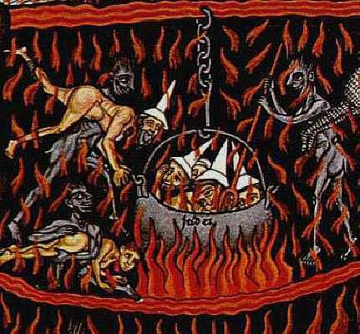
Our discomfort with hell
Consider these quotes: one from a Catholic tract for children and one from a Protestant sermon
How did they make you feel?
Most believers feel some discomfort with hell as traditionally understood

Slide 6
The problem of justice
Hell is defended on the basis of retributive justice
But how can a finite sin warrant an infinite punishment? How does that punishment fit the crime?
Anselm’s solution: a sin against an infinite being incurs an infinite demerit and warrants an infinite punishment. But …
The “ongoing sin in hell” solution. But …

Slide 7
The problem of love
Christians often say, “Of course God is a God of love, but he is also a God of justice and wrath”
Hell is about justice and wrath and these are important dimensions of the divine nature
But this is in danger of dividing God
All of God’s acts are manifestations of love and justice; of “holy love”
So — how is everlasting hell a manifestation of divine love to those in hell?

Slide 8
The problem of the joy of the redeemed
How can the redeemed in the new creation be full of perfect joy if some of those they love are lost forever with no hope of redemption?
The memory solution: God makes us forget them? But …
The transformation solution: God changes our instincts so that we see the beauty of his perfect justice in hell and rejoice at the torments of the damned. But …

Slide 9
The problem of freedom: Introduction
Two views of freedom: compatibilist and libertarian
Compatibilist: an action is freely chosen if (1) it is the action that the actor wants to perform
Libertarian: an action is freely chosen if (1) it is the action that the actor wants to perform, and (2) the actor could either perform or not perform the action
Christians stand on both sides of the disagreement

Slide 10
The problem of freedom: Compatibilism (Calvinism)
1. God, being omnipotent, could cause all people to freely choose to accept Christ
2. God, being omniscient, would know how to cause all people to freely accept Christ
3. God, being omnibenevolent, would want to cause all people to freely accept Christ
Now 1–3 entail
4. God will cause all people to freely accept Christ
5. Therefore, all people will freely accept Christ

Slide 11
The problem of freedom: Compatibilism (Calvinism)
So for Calvinists God could save everyone without violating anyone’s freedom. But he chooses not to.
Some have defended this divine choice by saying that God has to display the fullness of his glory in creation, and this is the glory of his love and the glory of his justice. But …
How is this view compatible with the claim that “God is love”?

Slide 12
The problem of freedom: Libertarianism (Molinism)
Molinism: God not only knows all the things that we could freely choose in situation x but also what we would freely choose if we were placed in situation x. So God can bring about his will without violating our freedom if he actualizes situations in which he knows that we will freely choose the right thing.
God can choose to actualize a possible world in which he knows we will all freely choose to accept him
So why would he not do so?

Slide 13
The problem of freedom: Thomas Talbott
Talbott argues that “if someone does something in the absence of any motive for doing it and in the presence of an exceedingly strong motive for not doing it, then he or she displays the kind of irrationality that is incompatible with free choice”
E.g., someone putting their hand in a fire when they believed they had no reason for doing so and strong reasons not to. We would not say the act was freely chosen.
The choice to submit to God’s gospel is directly analogous; making a fully informed decision to reject it makes no sense
So God could only create a situation in which people freely reject him forever if he acted to keep them from fully understanding the nature of their choice.
Given the terrible consequences, why would God do that?

Slide 14
The problem of freedom: Generic problems
Is the ability to choose something that is fundamentally irrational and for one’s eternal self-harm worth preserving for all time, at all costs? Or is its value more limited?
Does God allow his ultimate purposes for creation to depend on the irrational decisions of his creatures? Would that not be an act of reckless irresponsibility?

Slide 15
The problem of God
1. If God is all loving then God will want to redeem all people
2. If God is omniscient and omnipotent then God will know how to and be able to redeem all people
3. Therefore, God will redeem all people
The problem is this: if you wish to deny 3 and insert an eternal hell in its place you need to reject either 1 or 2.
To preserve hell is it worth sacrificing the divine perfections of love, knowledge, or power?

Slide 16
The problem of hell
Now eternal hell may be the sober truth and we simply have to face that
But there are enough concerns about the traditional interpretations of hell to at least make us wonder whether there is an orthodox Christian alternative
We will explore one such alternative: Christian universalism

